Slide 1
S130 Training
Runar B. Skjerve
Hong Kong / March / 2015
An introduction of the S130 Softdevice

Slide 2
S130 subjects
S130 Softdevice (2 days hands on workshop covering)
Harmonized API between S110, S120 and S130
S120/S130 API : Master-specific commands and messages
Master multi-link scheduling (RF activity, using S120 ?)
Concurrent Master and Slave scheduling
Additional RF activity (proprietary) impact
GATT multi-client/server capabilities
Device Manager
Current consumption calculation and considerations

Slide 3
Day 1
Softdevice API
Central specific commands and Events
Task_1 : Master - connection
GATT Server
GATT Client
Tasks 2 and 3: Master - GATT Client
https://github.com/Skjerve/nRF51-S130-HK
Presentation and tasks will be released here

Slide 4
S130 – Key features
Peripheral
1 connection
2-3 packets per connection event
Central
Can be connected to 3 Peripherals
1 packet per connection event
Scan + Connected to 2 peripherals
Concurrent broadcaster
Timeslot API
Will not be production level tested in S130 v1.0.0

Slide 5
Common softdevice API
S120 2.0.0
S110 8.0.0
S310 3.0.0
S130 1.0.0

Slide 6
Central role - Scanning
sd_ble_gap_scan_start (ble_gap_scan_params_t)
Start scanning (GAP Discovery procedure, Observer Procedure)
Results in BLE_GAP_EVT_ADV_REPORT {bdaddr, rssi, data}
sd_ble_gap_scan_stop(void)
Stops scanning
Alternativ stopped by BLE_GAP_EVT_TIMOUT {BLE_GAP_TIMEOUT_SRC_SCAN}
Notes:
p_scan_params Pointer to scan parameters structure

Slide 7
Central role - Scanning
ble_gap_scan_params_t
uint8_t active : 1;
If 1, perform active scanning (scan requests).
uint8_t selective : 1;
If 1, ignore unknown devices (non whitelisted).
ble_gap_whitelist_t * p_whitelist;
Pointer to whitelist, NULL if none is given.
uint16_t interval
uint16_t window;
Scan interval and window between 0x0004 and 0x4000 in 0.625ms units (2.5ms to 10.24s).
uint16_t timeout;
Scan timeout between 0x0001 and 0xFFFF in seconds, 0x0000 disables timeout.
Notes:
p_scan_params Pointer to scan parameters structure

Slide 8
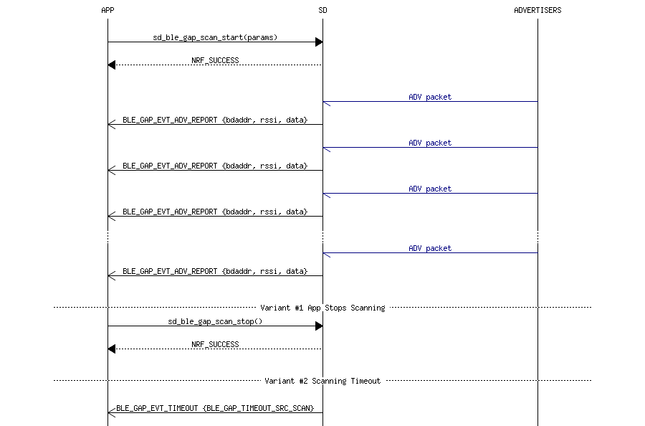
Central role - Scanning
sd_ble_gap_scan_start (ble_gap_scan_params_t)
Start scanning (GAP Discovery procedure, Observer Procedure)
Results in BLE_GAP_EVT_ADV_REPORT {bdaddr, rssi, data}
sd_ble_gap_scan_stop(void)
Stops scanning
Alternativ stoped by BLE_GAP_EVT_TIMOUT
Notes:
Two possible outcomes from scanning.

Slide 9
Central role - Scanning
Master scan interval = 50 ms
Master scan window = 25 ms
Scanning on channel 37
Scanning on channel 38
Scanning on channel 39
M
0 ms
25 ms
50 ms
75 ms
100 ms
125 ms
150 ms
S
0 ms
40 ms
80 ms
120 ms
Advertising on 37, 38 and 39
Slave Advertising interval = 40 ms
Notes:
From this we can see that the following advertising packets will be picked up by the scanning device: t=0 ch=37and t=120 ch=39. Note that there is no hit in the second scan period and that the advertisements at t=40 and t=80 is not received by the scanner.

Slide 10
Central role - Connecting
sd_ble_gap_connect (ble_gap_addr_t, ble_gap_scan_params_t, ble_gap_conn_params_t)
Create a connection (GAP Link Establishment).
Results in BLE_GAP_EVT_CONNECTED
sd_ble_gap_connect_cancel (void)
Cancel a connection establishment.
Alternatively BLE_GAP_EVT_TIMEOUT {BLE_GAP_TIMEOUT_SRC_CONN}
sd_ble_gap_disconnect (conn_handle,hci_status_code )
This call initiates the disconnection procedure.
Results in BLE_GAP_EVT_DISCONNECTED
Notes:
ble_gap_addr_t p_peer_addr Pointer to peer address. If the selective bit is set in @ref ble_gap_scan_params_t, then this must be NULL.
ble_gap_scan_params_t p_scan_params Pointer to scan parameters structure.
ble_gap_conn_params_t p_conn_params Pointer to desired connection parameters

Slide 11
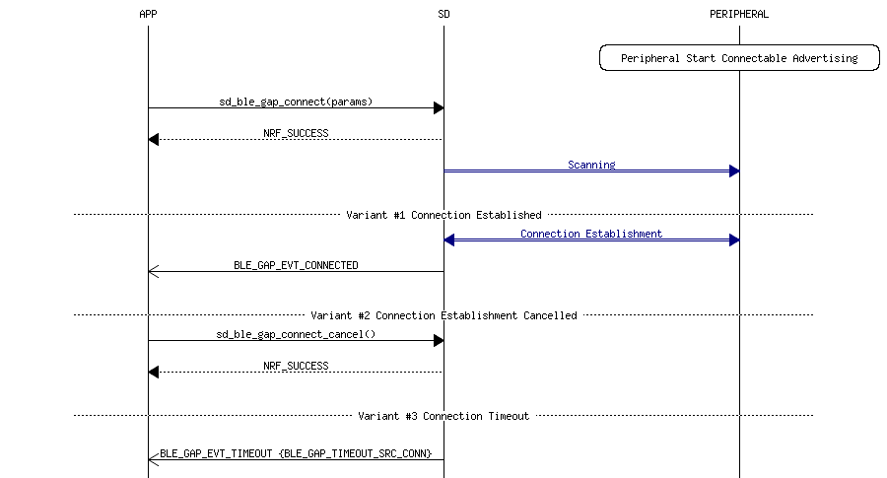
Central role - Connecting
Notes:
Three possible outcomes

Slide 12
Different API uses depending on role
sd_ble_gap_authenticate (conn_handle, ble_gap_sec_params_t)
In the central role, this function will send an SMP Pairing Request, otherwise in the peripheral role, an SMP Security Request will be sent.
sd_ble_gap_conn_param_update (conn_handle, ble_gap_conn_params_t)
In the central role this will initiate a Link Layer connection parameter update procedure
In the peripheral role, this will send the corresponding L2CAP request and wait for the central to perform the procedure. In both cases, and regardless of success or failure, the application will be informed of the result with a @ref BLE_GAP_EVT_CONN_PARAM_UPDATE event
sd_ble_gap_encrypt (conn_handle, ble_gap_master_id_t, ble_gap_enc_info_t)
In the central role, this function will initiate the encryption procedure using the encryption information provided (only central)
Notes:
sd_ble_gap_authenticate
ble_gap_sec_params_t p_sec_params
Pointer to the @ref ble_gap_sec_params_t structure with the security parameters to be used during the pairing procedure.
* In the peripheral role, only the timeout, bond and mitm fields of this structure are used.
In the central role, this pointer may be NULL to reject a Security Request.
sd_ble_gap_conn_param_update
ble_gap_conn_params_t p_conn_params
Pointer to desired connection parameters. If NULL is provided on a peripheral role, the parameters in the PPCP characteristic of the GAP service will be used instead.
sd_ble_gap_encrypt
ble_gap_master_id_t p_master_id Pointer to a @ref ble_gap_master_id_t master identification structure.
ble_gap_enc_info_t p_enc_info Pointer to a @ref ble_gap_enc_info_t encryption information structur
Note Calling this function may result in the following event depending on the outcome and parameters: @ref BLE_GAP_EVT_CONN_SEC_UPDATE

Slide 13
Task_1 : Master connection
Task_1: Scan for and connect to a peripheral.
Set up HRM example with a personal device name as peripheral. (From SDK 8.0.0)
Use the task 1 Start project with S120 v2.0.0.
Place this in the central example folder SDK 8.0.0
Tasks are marked @todo in the code
@todo 5: add timeout for connect, start scanning again on timeout.
Tip: ENABLE_DEBUG_LOG_SUPPORT

Slide 14
GATT server
Similar to S110 v8.0.0 and has multilink capabilities
Multilink related changes from S110 v7.1.0 to S110 v8.0.0:
The GATTS set and get operations for local values have changed:
The new function prototypes require a connection handle (since this is required for certain multi-value attributes) and also use a new structure ble_gatts_value_t for parameter input:
sd_ble_gatts_value_set(uint16_t conn_handle, uint16_t handle, ble_gatts_value_t *p_value)
sd_ble_gatts_value_get(uint16_t conn_handle, uint16_t handle, ble_gatts_value_t *p_value)
The GATTS set and get operations for system attributes have changed:
The new function prototypes include an additional parameter, flags, to allow for partial retrieval or storage of system attributes. If the application does not want to make use of this new functionality, it can simply set the flags parameter to 0.
sd_ble_gatts_sys_attr_set(uint16_t conn_handle, uint8_t const *p_sys_attr_data, uint16_t len, uint32_t flags)
sd_ble_gatts_sys_attr_get(uint16_t conn_handle, uint8_t *p_sys_attr_data, uint16_t *p_len, uint32_t flags)

Slide 15
GATT multilink capabilities
GATTS and GATTC functions require a connection handle to identify connection
Also implemented in S110 v8.0.0

Slide 16
GATT Client
sd_ble_gattc_primary_services_discover
sd_ble_gattc_relationships_discover
sd_ble_gattc_characteristics_discover
sd_ble_gattc_descriptors_discover
sd_ble_gattc_char_value_by_uuid_read
sd_ble_gattc_read
sd_ble_gattc_char_values_read
sd_ble_gattc_write
sd_ble_gattc_hv_confirm

Slide 17
GATT Client - discovery
sd_ble_gattc_primary_services_discover (conn_handle, start_handle, ble_uuid_t)
This function initiates a Primary Service discovery, starting from the supplied handle.
If the last service has not been reached, this must be called again with an updated start handle value to continue the search.
sd_ble_gattc_relationships_discover (conn_handle, ble_gattc_handle_range_t)
This function initiates the Find Included Services sub-procedure.
If the last included service has not been reached, this must be called again with an updated handle range to continue the search.
Notes:
SD_BLE_GATTC_PRIMARY_SERVICES_DISCOVER
Note: If any of the discovered services have 128-bit UUIDs which are not present in the table provided to ble_vs_uuids_assign, a UUID structure with type @ref BLE_UUID_TYPE_UNKNOWN will be received in the corresponding event.
SD_BLE_GATTC_RELATIONSHIPS_DISCOVER
Note: If any of the discovered characteristics have 128-bit UUIDs which are not present in the table provided to ble_vs_uuids_assign, a UUID structure with type @ref BLE_UUID_TYPE_UNKNOWN will be received in the corresponding event

Slide 18
GATT Client - discovery
sd_ble_gattc_characteristics_discover(conn_handle, ble_gattc_handle_range_t)
This function initiates a Characteristic discovery procedure.
If the last Characteristic has not been reached, this must be called again with an updated handle range to continue the discovery.
sd_ble_gattc_descriptors_discover (conn_handle, ble_gattc_handle_range_t)
This function initiates the Characteristic Descriptor discovery procedure.
If the last Descriptor has not been reached, this must be called again with an updated handle range to continue the discovery.

Slide 19
GATT Client - discovery
sd_ble_gattc_char_value_by_uuid_read (conn_handle, ble_uuid_t, ble_gattc_handle_range_t)
This function initiates the Read using Characteristic UUID procedure.
If the last Characteristic has not been reached, this must be called again with an updated handle range to continue the discovery.

Slide 20
GATT Client – Reading value
sd_ble_gattc_read (conn_handle, handle, offset)
This function initiates a GATT Read (Long) Characteristic or Descriptor procedure.
If the Characteristic or Descriptor to be read is longer than GATT_MTU - 1, this function must be called multiple times with appropriate offset to read the complete value.
sd_ble_gattc_char_values_read(conn_handle, handle, handle_count)
This function initiates a GATT Read Multiple Characteristic Values procedure.

Slide 21
GATT Client – Writing and confirming
sd_ble_gattc_write (conn_handle, ble_gattc_write_params_t)
This function can perform all write procedures described in GATT.
sd_ble_gattc_hv_confirm (conn_handle, handle)
Send a Handle Value Confirmation to the GATT Server
Message sequence charts in SDK documentation
Notes:
sd_ble_gattc_write
Note: It is important to note that a write without response will <b>consume an application buffer</b>, and will therefore generate a @ref BLE_EVT_TX_COMPLETE event when the packet has been transmitted. A write on the other hand will use the standard client internal buffer and thus will only generate a @ref BLE_GATTC_EVT_WRITE_RSP event as soon as the write response has been received from the peer. Please see the documentation of @ref sd_ble_tx_buffer_count_get for more details.

Slide 22
Database discovery module
ble_db_discovery_init (void)
Function for initializing the DB Discovery module.
ble_db_discovery_close (void)
Function for closing the DB Discovery module.
This function will clear up any internal variables and states maintained by the module.
Call ble_db_discovery_init again to re-use the module after calling this function,
ble_db_discovery_evt_register (ble_uuid_t, ble_db_discovery_evt_handler_t)
Function for registering with the DB Discovery module.
The total number of services that can be discovered by this module is BLE_DB_DISCOVERY_MAX_SRV.
This effectively means that the maximum number of registrations possible is equal to the BLE_DB_DISCOVERY_MAX_SRV.
Notes:
p_uuid Pointer to the UUID of the service to be discovered at the server
evt_handler Event handler to be called by the DB discovery module when any event related to discovery of the registered service occurs.

Slide 23
Database discovery module
ble_db_discovery_start (ble_db_discovery_t, conn_handle)
Function for starting the discovery of the Attribute table at the server.
ble_db_discovery_on_ble_evt (ble_db_discovery_t, const ble_evt_t)
Function for handling the Application's BLE Stack events.
Message sequence chart in SDK documentation
Notes:
https://devzone.nordicsemi.com/question/13718/ble_db_discovery_max_srv-implications/

Slide 24
Tasks 2: Master GATT Client
Rename the Target device in the example
The example should be placed in SDK 8.0.0 in the Central example folder
Use the Multilink peripheral code and use this as peripheral device
Rename the peripheral
Tasks are marked with @todo in the code
Notes:
Tips:
ble_db_discovery.c

Slide 25
Task 3:
Use your Finished version of Task 2 and connet to multiple peripherals

Slide 26
Day 2
Scheduling
Radio timeslot API
Task 3:
Device manager
Task 4: Device manager peripheral
Task 5: Device manger central
Current consumption and calculation

Slide 27
Recap
Common Softdevice API
Scanning
Connection esthablishment
GATT Client
Database Discovery

Slide 28
Scheduling
Time multiplexing
Central role links are placed so they don’t overlap.
Equal priorities are given to central and peripheral role
The Peripheral role link can come on top of central role so one of them could be blocked
Both roles start with the same priority
Priorities are raised 4 connection events before connection timeout
Peripheral role links have extra priorities in certain cases
Highest priority cannot be blocked
Connection parameter updates
Channel map updates?
Details in SDS

Slide 29
Radio timeslot API
Allows an application to schedule 2.4 GHz radio while using the softdevice
Normaly blocked pripherals are available for the length of the timeslot
RADIO, TIMER0, CCM, AAR and PPI
A timeslot can be requested at Normal or High priority
If the requested timeslot collides with an already scheduled activity with equal or higher priority, the request will be blocked
If a later arriving activity of higher priority causes a collision, the request will be canceled and the scheduled timeslot revoked.
A timeslot that has already started cannot be interrupted or canceled.
Timeslots requested at high priority will cancel other activities scheduled at lower priorities in case of a collision.
Note: Shorter timeslots are easier to fit into the schedule.
Can be extended
Notes:
NRF_RADIO_PRIORITY_HIGH High (equal priority as the normal connection priority of the SoftDevice stack(s)).
NRF_RADIO_PRIORITY_NORMAL Normal (equal priority as the priority of secondary activites of the SoftDevice stack(s))

Slide 30
Radio timeslot API
The application is responsible for keeping track of timing within the timeslot and ensuring that the application’s use of the peripherals does not last for longer than the granted timeslot.
TIME0 run at from zero, 1 MHz
Recommended to set up a timer interrupt to end the session
The signal handler runs at LowerStack priority
Cannot be interrupted by other activity
Use only for real time signal handling
Described in the Softdevice specification (S120 v2.1).
Time slot usage examples
Notes:
The recommended practice is to set up a timer interrupt that expires before the timeslot expires, with enough
time left of the timeslot to do any clean-up actions before the timeslot ends. Such a timer interrupt can also
be used to request an extension of the timeslot, but there must still be enough time to clean up if the
extension is not granted.

Slide 31
Radio timeslot API
sd_radio_session_open(nrf_radio_signal_callback_t)
Open a timeslot session.
The callback is used for signaling
sd_radio_session_close(void)
Close a timeslot session.
sd_radio_request(nrf_radio_request_t)
Request a timeslot.
Examples:
experimental_ble_app_multiactivity_beacon in SDK 8.0.0
nRF51-multi-role-conn-observer-advertiser on github
Notes:
sd_radio_session_open
Only one session can be open at a time.
* @note p_radio_signal_callback(@ref NRF_RADIO_CALLBACK_SIGNAL_TYPE_START) will be called when the radio timeslot
* starts. From this point the NRF_RADIO and NRF_TIMER0 peripherals can be freely accessed
* by the application.
* @note p_radio_signal_callback(@ref NRF_RADIO_CALLBACK_SIGNAL_TYPE_TIMER0) is called whenever the NRF_TIMER0
* interrupt occurs.
* @note p_radio_signal_callback(@ref NRF_RADIO_CALLBACK_SIGNAL_TYPE_RADIO) is called whenever the NRF_RADIO
* interrupt occurs.
* @note p_radio_signal_callback() will be called at ARM interrupt priority level 0. This
* implies that none of the sd_* API calls can be used from p_radio_signal_callback().
sd_radio_session_close
* @note Any current radio timeslot will be finished before the session is closed.
* @note If a radio timeslot is scheduled when the session is closed, it will be canceled.
* @note The application cannot consider the session closed until the @ref NRF_EVT_RADIO_SESSION_CLOSED
* event is received.
SD_RADIO_REQUEST
* @note The request type is determined by p_request->request_type, and can be one of @ref NRF_RADIO_REQ_TYPE_EARLIEST
* and @ref NRF_RADIO_REQ_TYPE_NORMAL. The first request in a session must always be of type
* @ref NRF_RADIO_REQ_TYPE_EARLIEST.
* @note For a normal request (@ref NRF_RADIO_REQ_TYPE_NORMAL), the start time of a radio timeslot is specified by
* p_request->distance_us and is given relative to the start of the previous timeslot.
* @note A too small p_request->distance_us will lead to a @ref NRF_EVT_RADIO_BLOCKED event.
* @note Timeslots scheduled too close will lead to a @ref NRF_EVT_RADIO_BLOCKED event.
* @note See the SoftDevice Specification for more on radio timeslot scheduling, distances and lengths.
* @note If an opportunity for the first radio timeslot is not found before 100ms after the call to this
* function, it is not scheduled, and instead a @ref NRF_EVT_RADIO_BLOCKED event is sent.
* The application may then try to schedule the first radio timeslot again.
* @note Successful requests will result in nrf_radio_signal_callback_t(@ref NRF_RADIO_CALLBACK_SIGNAL_TYPE_START).
* Unsuccessful requests will result in a @ref NRF_EVT_RADIO_BLOCKED event, see @ref NRF_SOC_EVTS.
* @note The jitter in the start time of the radio timeslots is +/- @ref NRF_RADIO_START_JITTER_US us.
* @note The nrf_radio_signal_callback_t(@ref NRF_RADIO_CALLBACK_SIGNAL_TYPE_START) call has a latency relative to the
* specified radio timeslot start, but this does not affect the actual start time of the timeslot.
* @note NRF_TIMER0 is reset at the start of the radio timeslot, and is clocked at 1MHz from the high frequency
* (16 MHz) clock source. If p_request->hfclk_force_xtal is true, the high frequency clock is
* guaranteed to be clocked from the external crystal.
* @note The SoftDevice will neither access the NRF_RADIO peripheral nor the NRF_TIMER0 peripheral
* during the radio timeslot.

Slide 32
Task 4: Run S130 example from SDK 8.0
Connect to two peripherals
Tip: scanning is not used, so peripherals are identified using the device address
Use master control panel as central and connect to the S130 peripheral
Modify the advertisement data so you can identify your S130 peripheral.
The S130 should have:
1 Peripheral role Connection, Master control panel as central
1 Central role connection, Use S110 with Heart rate example as peripheral.
Reference the S130 example user guide for instructions.

Slide 33
Recap
Common Softdevice API
Scanning
Connection esthablishment
GATT Client
Database Discovery
Scheduling/priorities
Radio timeslot api

Slide 34
Scheduling
1. BLE Highest priority
Will be scheduled ahead as the softdevice know when this is going to happen.
Slave Connection parameter update on instant
Connection setup -> first connection event
2. BLE High priority
3. Timeslot High priority
4. Scheduled Normal
5. BLE Normal and Timeslot Normal
Equal priority = first come first serve.

Slide 35
Device manager
Handles persistent storage of contextual information
Manages Active and Bonded Peers
Security Keys, GATT configuration and any application specific information
Contextual information is required to be retained on disconnection and power cycling for bonded peers
This module categorizes the contextual information into 3 categories:
Bonding Information
Service/Protocol Information
Application Information

Slide 36
Bonding
No encryption = No Bond
Just work
Encryption, but no authentication
MITM
Encryption with authentication
OOB
Encryption with authentication
It is also possible to use only pairing.
Encryption
No bond information to retain.

Slide 37
When should we bond
iOS and Android
When the GATT client receives an ‘ATT error: insufficient auhentichation’
Win 8:
Sends SMP pairing request regardless,
except for when connecting to the nRF8001 (uses LL_Version_ind to identify the chip)
How:
In central role
Send SMP Pairing Request
In peripheral role,
Send SMP Security Request
It is common that the peripheral send a SMP security request when reconnecting to a already bonded device.

Slide 38
Device manager - Bonding Information
Bond information is the information exchanged between local and peer device to establish a bond. It also includes peer identification information, like the peer address or the IRK or both. From here on this category of information is referred to as Device Context.
EDIV – Used to identify LTK
RAND – Used to identify LTK
IRK – used for whitelisting with private resolvable address (iOS)
Device Address – Used for whitelisting static addresses (public and random)
LTK – Used to encrypt when re-establishing a bond
Ellisys trace that shows bonding

Slide 39
Device Manager - Service/Protocol Information
Service/Protocol information is the information retained for the peer to save on one-time procedures like the GATT Service Discovery procedures and Service Configurations. It allows devices to resume data exchange on subsequent reconnection without having to perform initial set-up procedures each time. From here on this category is referred to as Service Context.
For GATT server: CCCD values (6bytes)
2 first bytes are the handle,
2 bytes is the length of the data
2 bytes data

Slide 40
Device manager - Application Information
Application information is the context that the application would like to associate with each of the bonded device. For example, if the application chooses to rank its peers in order to manage them better, the rank information could be treated as Application Information. This storage space is provided to save the application from maintaining a mapping table with each Device Instance and Application Information. However, if the application have no use for this, it is possible to not use or employ this at compile time. From here on this category of information is referred to as Application Context.

Slide 41
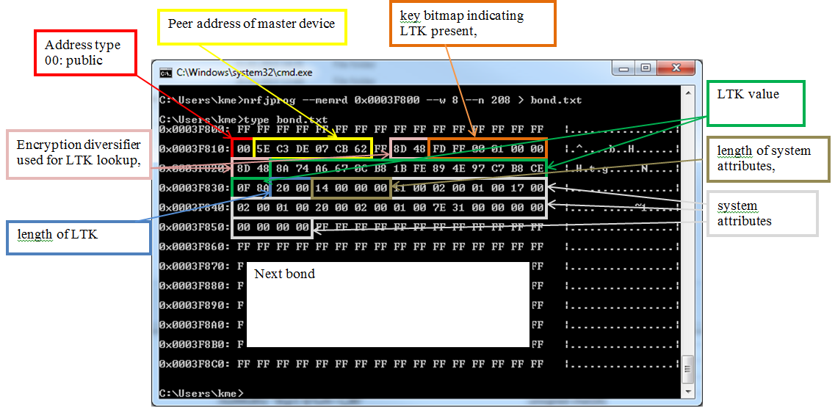
Device manager – Flash content

Slide 42
Device manager - Set-up APIs
dm_init(dm_init_param_t );
Must called before any other APIs of the module are used
dm_init_param_t
bool clear_persistent_data; /**< Set to true in case the module should clear all persistent data.
E.g. init_param.clear_persistent_data = false;
Notes:
dm_init_param_t
bool clear_persistent_data; /**< Set to true in case the module should clear all persistent data.

Slide 43
Device manager - Set-up APIs
dm_register(dm_application_instance_t , dm_application_param_t );
used by the application to register for asynchronous events with the device manager.
During registration the application also indicates the services that it intends to support on this instance.
At least one instance shall be registered with the device manager after the module has been initialized.
DM_MAX_APPLICATIONS = Maximum number of application instances device manager can support. (currently max 1)
It will be possible to register multiple times with the device manager in the future. (not implemented yet)
Notes:
Application Instance.
Application instance uniquely identifies an application. The identifier is allocated by the device manager when application registers with the module. The application is expected to identify itself with this instance identifier when initiating subsequent requests. Application should use the utility API dm_application_instance_set in order to set its application instance in dm_handle_t needed for all subsequent APIs. See also dm_register.
dm_application_param_t
dm_event_cb_t dm_application_param_t::evt_handler
Event Handler to be registered. It will receive asynchronous notification from the module, see Device Manager Events for asynchronous events.
Event notification callback registered by application with the module.
Event notification callback registered by application with the module when registering the module using dm_register API.
Parameters [in]p_handleIdentifies the peer for which the event is being notified. [in]p_eventIdentifies the event, any associated parameters and parameter length. See Device Manager Events for details on event types and their significance. [in,out]event_resultProvide additional information on the event. In addition to SDK error codes there is also a return value indicating if maximum number of connections has been reached when connecting or bonding.
uint8_t dm_application_param_t::service_type
Bit mask identifying services that the application intends to support for all peers.
ble_gap_sec_params_t dm_application_param_t::sec_param
GAP security parameters.

Slide 44
Device manager - Set-up APIs
dm_ble_evt_handler(ble_evt_t);
BLE Event Handler for the module. This routine should be called from BLE stack event dispatcher for the module to work as expected.
app_evt_notify is called from dm_ble_evt_handler
app_evt_notify(&dm_handle, &dm_event, result);
This forwards events to the device_manager_event_handler
Registered with dm_register

Slide 45
Device manager - APIs to set up or read status of security on a link.
dm_security_setup_req(dm_handle_t * p_handle);
This API initiates security procedures with a peer device.
For the GAP Central role, in case peer is not bonded, request to bond/pair is initiated. If it is bonded, the link is re-encrypted using the existing bond information.
For the GAP peripheral role, a Slave security request is sent.
If a pairing procedure is initiated successfully, application is notified of DM_EVT_SECURITY_SETUP_COMPLETE. A result indicating success or failure is notified along with the event.
In case the link is re-encrypted using existing bond information, DM_EVT_LINK_SECURED is notified to the application.
p_handle Identifies the link on which security is desired.
Notes:
In the SDK implementation this is Triggered by
BLE_GAP_EVT_SEC_REQUEST
BLE_GATT_STATUS_ATTERR_INSUF_AUTHENTICATION
BLE_GATT_STATUS_ATTERR_INSUF_ENCRYPTION

Slide 46
Device manager - APIs to set up or read status of security on a link.
dm_security_status_req(dm_handle_t , dm_security_status_t );
This API allows application to query status of security on a link
p_handle
Identifies the link on which security is desired.
p_status
Pointer where security status is provided to the application.
ref dm_security_status_t for possible statuses that can be expected.
NOT_ENCRYPTED, /**< The link is not secured. */
ENCRYPTION_IN_PROGRESS, /**< Link security is being established.*/
ENCRYPTED /**< The link is secure.*/

Slide 47
Device manager - APIs to set up or read status of security on a link.
dm_whitelist_create(dm_application_instance_t, p_whitelist);
This API allows the application to create a whitelist based on bonded peer devices in the module data base
p_handle
Identifies the application requesting whitelist creation.
p_whitelist
Pointer where created whitelist is provided to the application.
Notes:
* @note
'addr_count' and 'irk_count' fields of the structure should be populated with the maximum number of devices that the application wishes to request in the whitelist.
If the number of bonded devices is less than requested, the fields are updated with that number of devices.
If the number of devices are more than requested, the module will populate the list with devices in the order the bond was established with the peer devices. Also, if this routine is called when a connection exists with one or more peer devices, those connected devices are not added to the whitelist.

Slide 48
Device manager – Context Management APIs.
dm_device_add (dm_handle_t *p_handle, dm_device_context_t const *p_context)
dm_device_delete (dm_handle_t const *p_handle)
Function for deleting a peer device context and all related information from the database.
dm_device_delete_all (dm_application_instance_t const *p_handle)
Function for deleting all peer device context and all related information from the database.
dm_service_context_set (dm_handle_t const *p_handle, dm_service_context_t const *p_context)
Function for setting Service Context for a peer device identified by 'p_handle' parameter.
dm_service_context_get (dm_handle_t const *p_handle, dm_service_context_t *p_context)
Function for getting Service Context for a peer device identified by 'p_handle' parameter.
dm_service_context_delete (dm_handle_t const *p_handle)
Function for deleting a Service Context for a peer device identified by the 'p_handle' parameter.
Notes:
* @note
'addr_count' and 'irk_count' fields of the structure should be populated with the maximum number of devices that the application wishes to request in the whitelist.
If the number of bonded devices is less than requested, the fields are updated with that number of devices.
If the number of devices are more than requested, the module will populate the list with devices in the order the bond was established with the peer devices. Also, if this routine is called when a connection exists with one or more peer devices, those connected devices are not added to the whitelist.

Slide 49
Device manager – Context Management APIs.
dm_application_context_set (dm_handle_t const *p_handle, dm_application_context_t const *p_context)
Function for setting Application Context for a peer device identified by the 'p_handle' parameter.
dm_application_context_get (dm_handle_t const *p_handle, dm_application_context_t *p_context)
Function for getting Application Context for a peer device identified by the 'p_handle' parameter.
dm_application_context_delete (dm_handle_t const *p_handle)
Function for deleting Application Context for a peer device identified by the 'p_handle' parameter.

Slide 50
Device manager – Utility APIs.
dm_application_instance_set (dm_application_instance_t const *p_appl_instance, dm_handle_t *p_handle)
Function for Setting/Copying Application instance to Device Manager handle.
dm_peer_addr_get (dm_handle_t const *p_handle, ble_gap_addr_t *p_addr)
Function for getting a peer's device address.
dm_peer_addr_set (dm_handle_t const *p_handle, ble_gap_addr_t const *p_addr)
Function for setting/updating a peer's device address.
dm_handle_initialize (dm_handle_t *p_handle)
Function for initializing Device Manager handle.
dm_distributed_keys_get (dm_handle_t const *p_handle, dm_sec_keyset_t *p_key_dist)
Function for getting distributed keys for a device.
dm_handle_get (uint16_t conn_handle, dm_handle_t *p_handle)
Function for getting the corresponding dm_handle_t based on the connection handle.

Slide 51
Device manager - SDK
What do we get from the SDK examples?
device_manager_init(void)
device_manager_event_handler(
dm_handle_t * p_handle,
dm_event_t * p_event,
ret_code_t event_result)
Device_manager_central.h and .c
dm_ble_evt_handler

Slide 52
Device manager - SDK
Look at message sequence charts in SDK documentation

Slide 53
Task 5: Device manager central
Task template
@Todo
Initialize Device manager
Add Device manager ble event handler
Test with multilink peripheral

Slide 54
Current consumption and calculation
Maintaining a peripheral role connection is the same as for S110
Central role connection is approxematily the same as for S110
Due to window widening the Peripheral role is in RX for sligthly longer this the current consumtion is actually lower for the central role as soon as the connection is esthablished
1 central role connection + 1 peripheral role connection
= 2 x S110 connections
Assuming same connection parameters and data transfer
3 Centrale role connections = approx. 3x S110 peripheral connections
Assuming same connection parameters and data transfer
Scanning consumes power
Staying in RX mode for a long time
Calculate consumption by using the RX current and estimate the time it will be scanning.

Slide 55
Task 6: Device manager peripheral
Enable bonding requirement in Heart rate example SDK 8.0.0

Slide 56
Task 7: Device manager peripheral
Enable Bonding in the UART peripheral example in SDK 8.0.0
Look at a project that already has bonding enabled
Verify with phone or the mastercontrol panel.
Use the nRF sniffer to capture a sniffer log
Compatible with Wireshark 1.10.13 and possibly 1.12.x
Add the Devicemanager to the project
This means you will have to include some files (compile project after adding device manger to see which files to add)
Add code to initialize device manager
Add dm_ble_evt_handler
Some events are already handled in the exapmle these needs to be reomved
Add pstorage to sys_evt_dispatch
CCCD must be readable with no authentication, changing this will giva an invalid paramter
Core spec limitation

Slide 57
S110 v7.1 vs 8.0

Slide 58
Summary
You can find this information in
SDK documentation
Message sequence charts
Softdevice Specification
S130 SDS will berelease with S130 v1.0.0
Softdevice release notes
Softdevice migration notes
Questions can be asked in devzone or on mypage
https://devzone.nordicsemi.com

